Slide 1
GSM Based Water Pump Control System
Presented by Group No 8: Ayman Attar – 27
Sumedh Pathrudkar - 14
Bhagyashri Kalkure - 30

Slide 2
INDEX
ABSTRACT
INTRODUCTION
LITERATURE SURVEY
BLOCK DIAGRAM
ADVANTAGES
APPLICATIONS
FUTURE SCOPE
REFERENCES

Slide 3
ABSTRACT
In present days, we prefer automation in every sector. Automated systems are bendy to use. It offers large precision and consistency with high term operation as fair as the manual operated systems.
Our proposed system is the automation of the Electric Water Pump used in households, industries, agriculture etc. Our effort is to make and achieve the mechanization implementation to manage electrical motor with the help of GSM module.
With this the user can monitor the Water Pump by just sending commands through the SMS. The demonstration given here is of the agriculture use case. The main contribution of this work is to offer automatic water supply for plants to saving time as well as water.

Slide 4
This will ease the work of farmers as they can monitor the Water Pump by just sending commands through SMS which will reduce their physical work.
The proposed system is controlled by Arduino to turn ON/OFF of pump by checking the moister level with the help of moisture sensors. In this work, the GSM technology is also used to switch ON/OFF of the pump using mobile phone by sending the commands to the kit through the GSM modem.

Slide 5
INTRODUCTION
Agriculture based economy could lead a country towards an economically independent nation. Undoubtedly, India is an agricultural country, and its economy depends on farming.
One of the essential elements for successful farming is that we should lighten the burden on the farmers so that their productivity level can be increased. We can reduce the burden on farmers by automating the water supply system. That’s not a lot but can be helpful.
Our proposed system does the same. It automates the monitoring of the water supply and water requirements of the plants with the help of specific sensors.
In the traditional water supply system the farmer would have to monitor the water supply by himself and would have to turn on and off the water pump accordingly. But in this system the controller will do the work for farmer.

Slide 6
It will continuously monitor the moisture in the soil and if the moisture level goes down below certain level the controller will itself turn on the water pump.
Besides the system also gives the farmer full control of the water pump. He can turn on and off the pump whenever it is necessary by just sending a text message through his mobile phone.
This will not only lighten the burden of the farmer but also will help him reduce the wastage of water and much more.

Slide 7
LITERATURE SURVEY
Sr. No. | Papers | Year of Publish | Author | Method Used
1. | Smart Monitoring of Agricultural Field And Controlling of Water Pump Using Internet of Things | 2019 | Mr.M.Suresh, S.Ashok, S.Arun Kumar, Puppala Sairam | IOT
2. | Solar Based Automatic Irrigation System with GSM Module | 2019 | Md. Munirul Islam Tusher, Md. Zahirul Haque, Mohammad Jalal Uddinǂ , Arif Mainuddin , Mohammad Ehsanul Hoque, Md. Mohin Uddin Talukder | Embedded System
3. | Automatic Water Supply System for Plants by using Wireless Sensor Network | 2017 | Santhosh Hebbar, Golla Vara Prasad | Embedded System
4. | DESIGNING A CENTRAL CONTROL UNIT AND SOIL MOISTURE SENSOR BASED IRRIGATION WATER PUMP SYSTEM | 2013 | Pulkit Hanswal, Ojaswi Dale, Deepika Gupta, R. N. Yadav MANIT | Embedded System

Slide 8
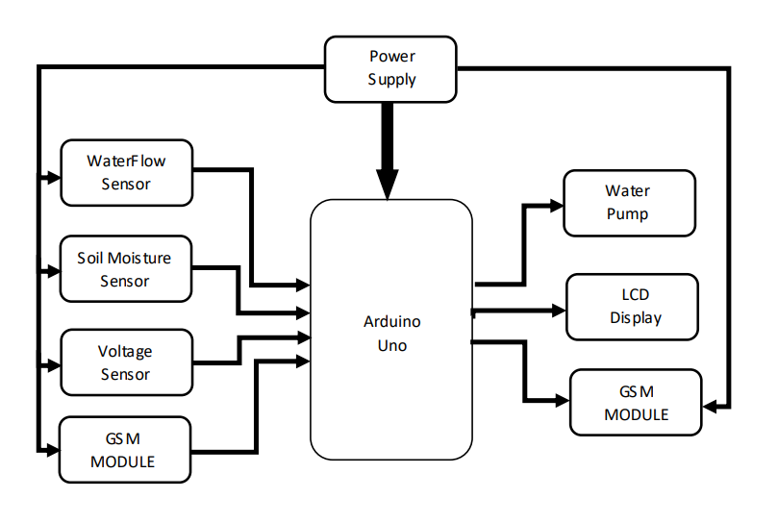
BLOCK DIAGRAM

Slide 9
ADVANTAGES
Use of this system will save farmers time and money.
Reduces the burden of farmers also increases their productivity.
Farmers can control land moisture from a remote location.
It can be easily implemented in the fields.
It is user friendly.

Slide 10
APPLICATIONS:
This system can be used in the agricultural watering pumps.
It also has wide applications in the industrial as well as household water pumps

Slide 11
FUTURE SCOPE
Addition of IOT to the system would give great outcomes.
PLC version can also be designed for factories

